Slide 1







Developer Survey
Tina Villa
11/29/2023

Slide 2



OUTLINE
Executive Summary
Introduction
Methodology
Results
Visualization – Charts
Dashboard
Discussion
Findings & Implications
Conclusion
Appendix

Slide 3

EXECUTIVE SUMMARY
Stack Overflow Developer Survey of 2019
Survey taken of 11,398 Developers related to:
Current use of languages, databases, platforms and webframes.
Desired use next year of languages, databases, and platforms, and webframes.
Demographics related to gender, age, education, and country origin.
Dashboards to illustrate most used by Developers, desired future learning and technologies.

Slide 4

INTRODUCTION
Data from Developers to gain a better understanding of current technologies from around the world.
Future trends in desired Developer technologies.
Identifying future technologies
Allows company to better equip themselves to invest in growing technologies.
Invest in knowledge based learning in developer education.

Slide 5

METHODOLOGY
A Quantitative research method was used to survey Stack Overflow Developers in 2019 which resulted in two saved CSV files: Demographics contained country, Education level, Developer type, experience, age, gender, job satisfaction and ethnicity among others. Technologies contain information on language, databases, platform, and web frames worked with and desire to learn.
Jobs API data used a URL in an SN labs environment, using Python, referencing number of job postings per language, and saved in an excel spreadsheet.
Popular languages data was obtained using web scrapping om the SN lab environment organized with Python, table of annual salary of the top 10 languages as an CSV file.

Slide 6
RESULTS
The data collected was loaded in an IBM database​
Cognos Dashboard Embedded use to create​ graphs of
Current Technology usage​
Future Technology trends​
Demographics ​
Annual salary of the top 10 languages
Job postings in each city

Slide 7
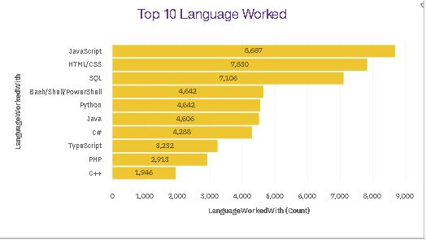
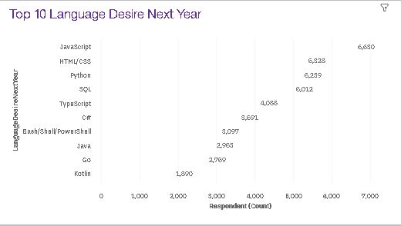
PROGRAMMING LANGUAGE TRENDS
Current Year
Next Year
<Bar chart of top 10 programming languages for the current year goes here.>
< Bar chart of top 10 programming languages for the next year goes here.>

Slide 8
PROGRAMMING LANGUAGE TRENDS - FINDINGS & IMPLICATIONS
Findings
JavaScript is the current/desired language most utilized.
HTML/CSS is second with current/desired language.
Katlin and Go language have a desire to learn that isn't in the most current language.
Implications
Investigate languages Katlin and Go to see what this new language technology offers that isn't available with Top current languages.
New tech language may require training

Slide 9
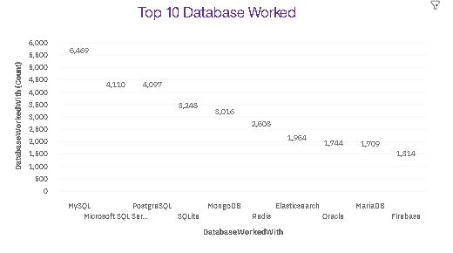
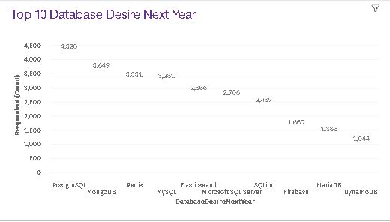
DATABASE TRENDS
Current Year
Next Year
< Bar chart of top 10 databases for the current year goes here >
< Bar chart of top 10 databases for the next year goes here.>

Slide 10
DATABASE TRENDS - FINDINGS & IMPLICATIONS
Findings
My SQL is top current Database dipped to 4th in desire to learn
MicroSoft SQL is 2nd in current dipped to 6th in desire to learn.
DynamoDB made it on the top 10 with desire to learn next year.
Implications
Emerging New Database with DynamoDB?
What technologies/differences does each Database offer?

Slide 11

DASHBOARD
https://dataplatform.cloud.ibm.com/dashboards/99453346-ff79-4749-85ef-3c7dbddd3d9a/view/7034fe3b6e8d38d117ccc4e407cc7a052e322508e3bb8103d6837b490d672497a96c1494c87c1d0ed8430235f4ed100bcd

Slide 12
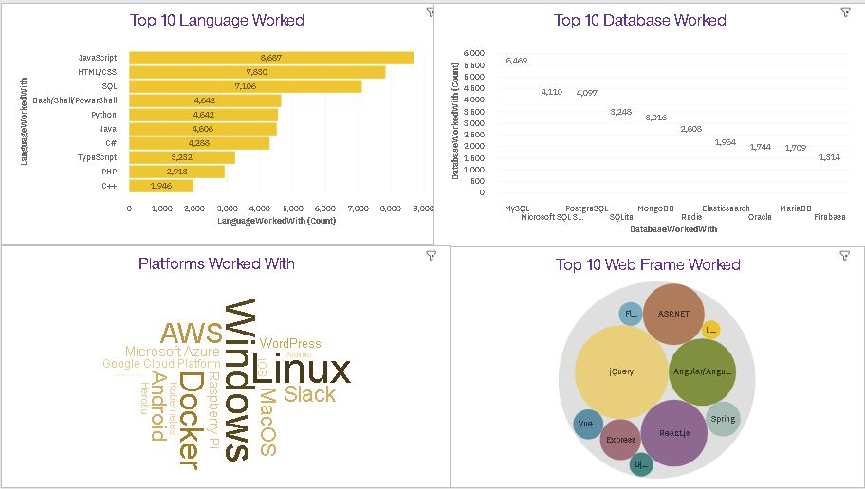
DASHBOARD TAB 1
Screenshot of dashboard tab 1 goes here

Slide 13
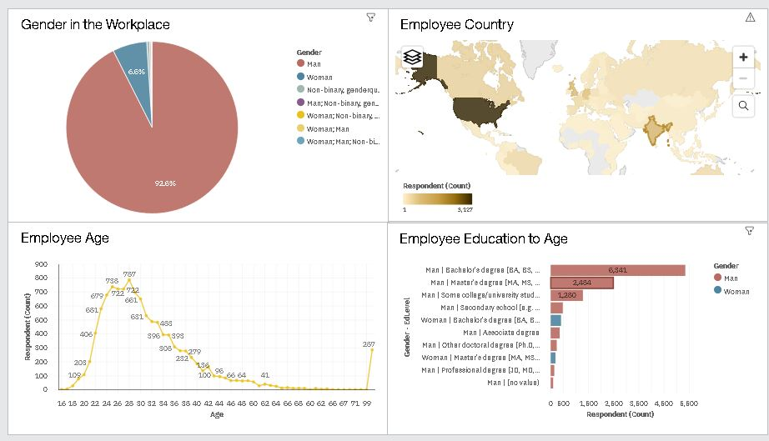
DASHBOARD TAB 3
Screenshot of dashboard tab 3 goes here

Slide 14
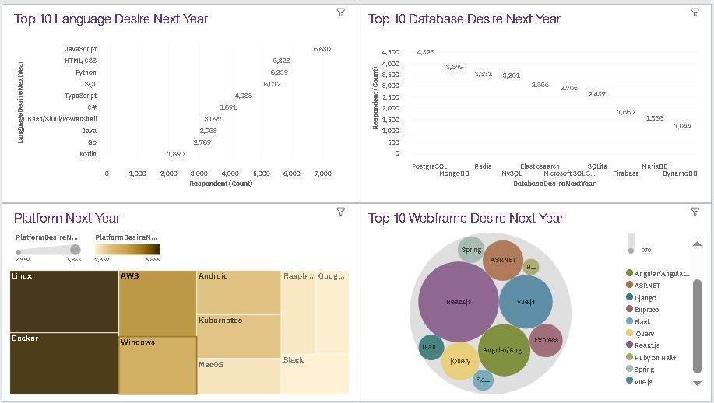
DASHBOARD TAB 2
Screenshot of dashboard tab 2 goes here

Slide 15
DISCUSSION
Keeping up with current trends and emerging technologies.
Continuing education investment ideas?
How to get more women in the field of Developers through college focused internship with female mentors?

Slide 16
OVERALL FINDINGS & IMPLICATIONS
Findings
DynamoDB made it to the top 10 Desire to learn which was not on the current Databases.
Katlin and Go made it on the top 10 languages to learn next year and not on the list for current.
Men dominate the Developer field verses women only 6.8 percent.
Implications
Emerging Database with more advanced technologies.
Improved languages with better features.
With emerging technologies may result in developers not having the tools to keep up with more improved data.
Women with Tech majors will not enter field because of lack of inclusion.

Slide 17

CONCLUSION
Keeping up with up and coming emerging technologies of Languages and Databases.
Provide incentives for continuing education in emerging technologies.
Ways to get more women in the Developer field through focused mentorships.

Slide 18

APPENDIX
Include any relevant additional charts, or tables that you may have created during the analysis phase.

Slide 19
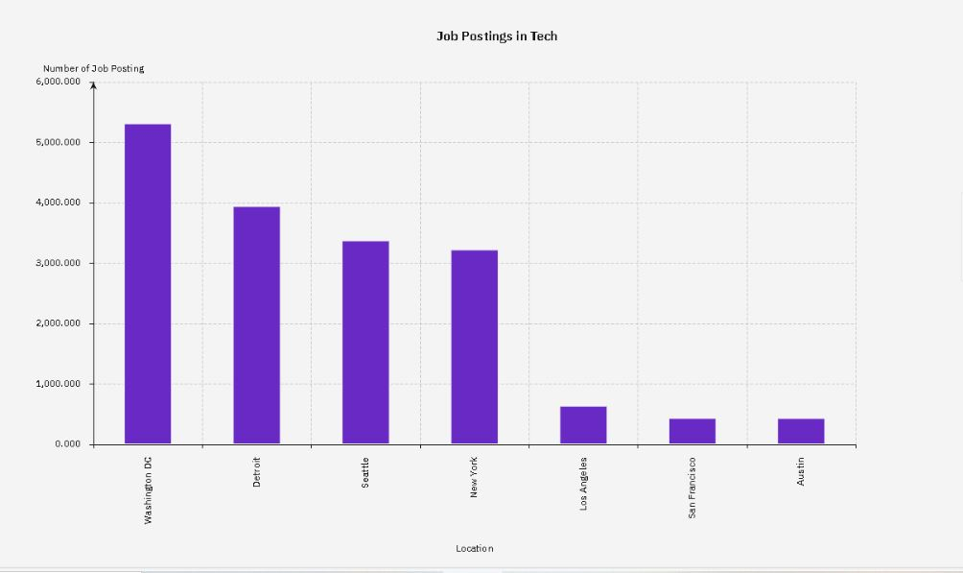
JOB POSTINGS
In Module 1 you have collected the job posting data using Job API in a file named “job-postings.xlsx”. Present that data using a bar chart here. Order the bar chart in the descending order of the number of job postings.

Slide 20
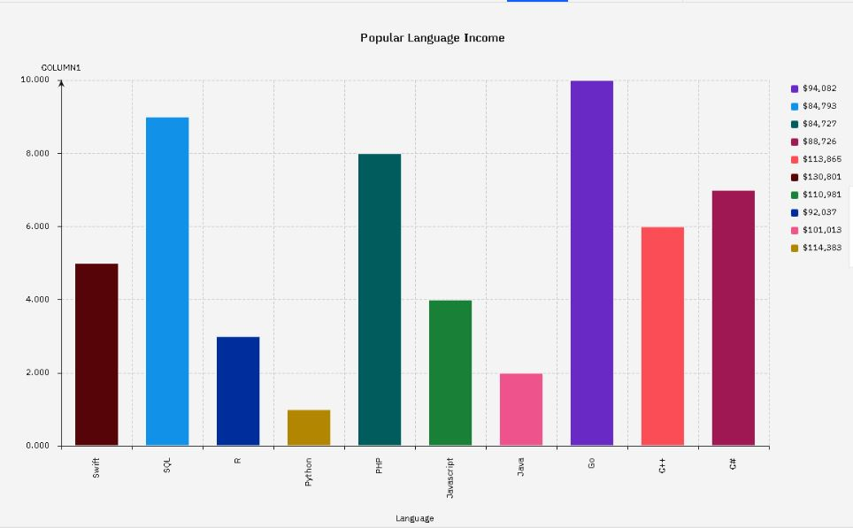
POPULAR LANGUAGES
In Module 1 you have collected the job postings data using web scraping in a file named “popular-languages.csv”. Present that data using a bar chart here. Order the bar chart in the descending order of salary.

